Slide 1
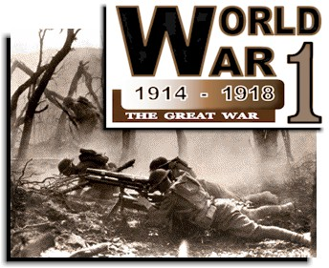
WWI
Take note

Slide 2
See primary source

Slide 3
Europe in reference to the world

Slide 4
Map of Europe during WWI

Slide 5
Neutral
Take note
not taking part or giving assistance in a dispute or war between others.

Slide 6
Our president at the time was Woodrow Wilson.
Take note

Slide 7
What caused WWI?
Take note

Slide 8
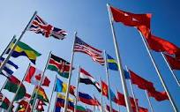
1-Nationalism-strong pride in ones country.
Take note
Notes:
Nationalism made citizens feel that they were the best. For example you have practices with a sport all season long, you feel your team is the best and you cant wait to play another team to show off.

Slide 9
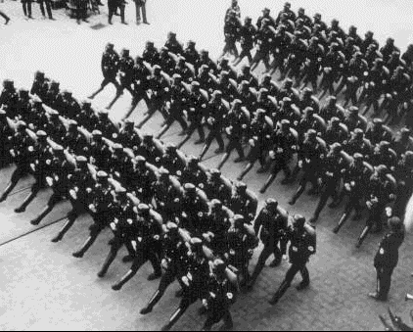
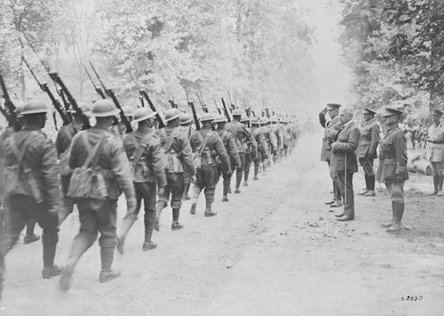
2-Militarism
Take note
Militarism- building up of a strong military.

Slide 10
See video

Slide 11
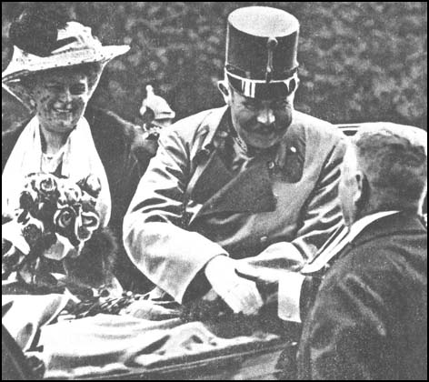
“The shot heard around the world”
Take note
3-The murder of Archduke Franz Ferdinand.
Notes:
This was just the excuse that some countries were waiting for to put their armies to use.

Slide 12
Gavrilo Princip- 19 years old from Serbia was responsible for the murder.
Take Note

Slide 13
4-Alliances
Take note
Alliances- Is an agreement among people or nations to unite for a common cause.

Slide 14
WWI Alliances
The Central Powers
-Austria-Hungary
-Germany
-Turkey (Ottoman Empire)
-Bulgaria
The Allies
-Russia (dropped out in 1917)
-France
-The United Kingdom
-Italy (joined 1915)
-United States (joined 1917)

Slide 15
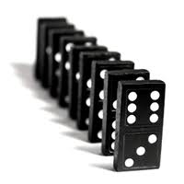
Domino Effect
Copy note
Austria-Hungary declares war on Serbia.
Russia declares war on Austria-Hungary.
Germany declares war on Russia.
Germany invades Belgium and United Kingdom declares war on Germany.

Slide 16
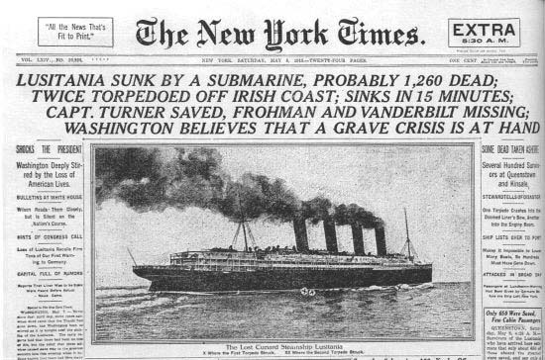
Why did the U.S. enter the war?
Take note
4 U.S. merchant ships were sank in the Atlantic Ocean by German U-boats.

Slide 17
German U Boat
See video

Slide 18
German U Boat

Slide 19
See Video clip

Slide 20
Zimmerman Telegram
Take note
Germany asked Mexico to be on their side if the U.S. entered the war. In return Germany would give them money for the war and help them regain land that once belonged to Mexico.

Slide 21
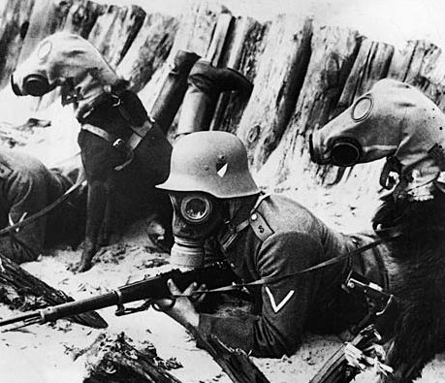
German dogs with gas masks

Slide 22
Dogs were used to help detect mines and help wounded soldiers.
Take note

Slide 23
Why is Trench Warfare not the best way to fight?

Slide 24
Primary source
Read letter from WWI

Slide 25
Life in the Trenches

Slide 26
Trench Warfare

Slide 27
Machine guns

Slide 28
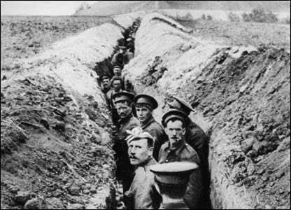

Slide 29
No mans land

Slide 30
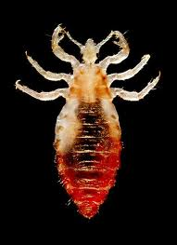
Lice

Slide 31
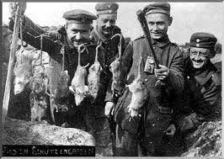
Had to compete with rats for food! In addition they carried diseases.

Slide 32
The next slide might seem funny to you but it was real life for the soldiers in the trenches.

Slide 33
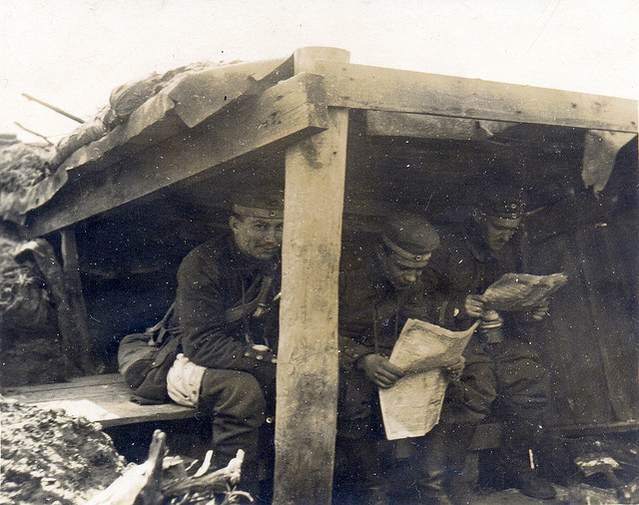
Latrines
Take note
Latrines were holes dug into the ground to use the RR.

Slide 34
Trench Foot
Take note j/k
Many soldiers fighting in the WWI suffered from trench foot. This was an infection of the feet caused by cold, wet and insanitary conditions. In the trenches men stood for hours on end in trenches with water without being able to remove wet socks or boots. The feet would gradually go numb and the skin would turn red or blue. If untreated, trench foot could turn gangrenous and result in amputation. Trench foot was a particular problem in the early stages of the war. For example, during the winter of 1914-15 over 20,000 men in the British Army were treated for trench foot.."

Slide 35
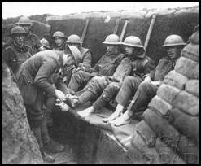
Trench Foot

Slide 36
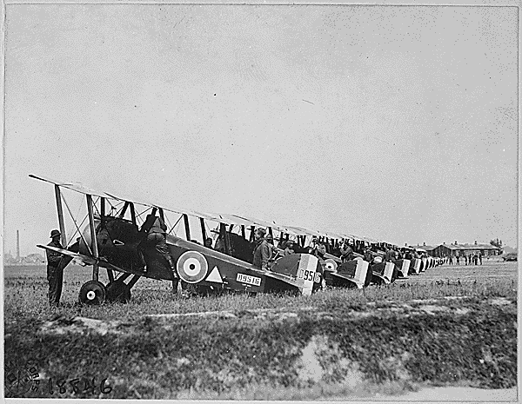
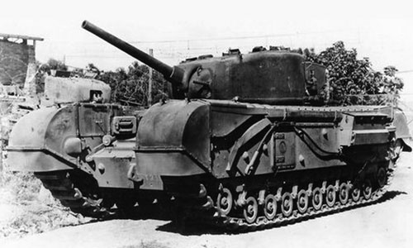
New weapons changed the way war was fought .
Take note
Grenades
Mustard gas
Fighter planes
Machine guns
Flame throwers
Tanks
Submarines

Slide 37
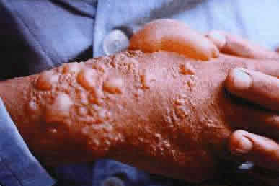
Weapons
Skin blisters from mustard gas.

Slide 38
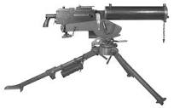
Machine guns

Slide 39
Planes

Slide 40
Flame Throwers

Slide 41
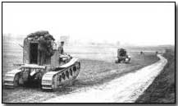
Tanks

Slide 42
Effects of WWI
Take note
22,000,000 million people died.
Cities destroyed.
A lot of people left poor & homeless.
New countries created. Old countries deleted.

Slide 43
See WWI video 5 min

Slide 44
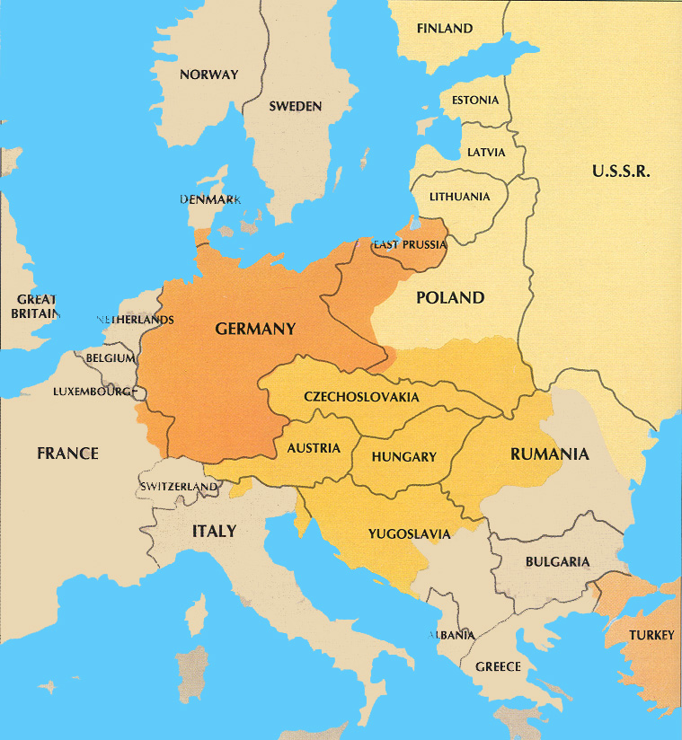
Germany was to blame for the war!
Take note

Slide 45
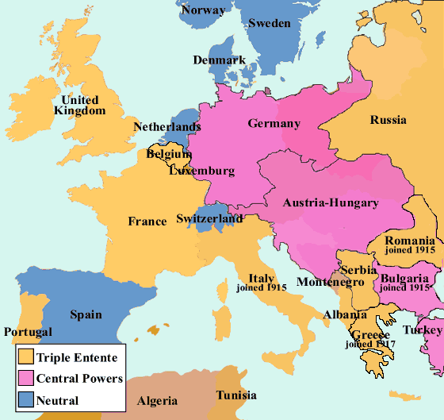
Map of Europe before/after WWI

Slide 46
The causes of WWI
1-Nationalism
2-Militarism
3-Murder of the Archduke
4-Alliances

